Slide 1
Building Event-Driven Applications Using Azure
Dustin Ewers
Centare
www.dustinewers.com
https://www.linkedin.com/in/dustinewers/
https://github.com/DustinEwers/event-driven-arch-azure

Slide 2
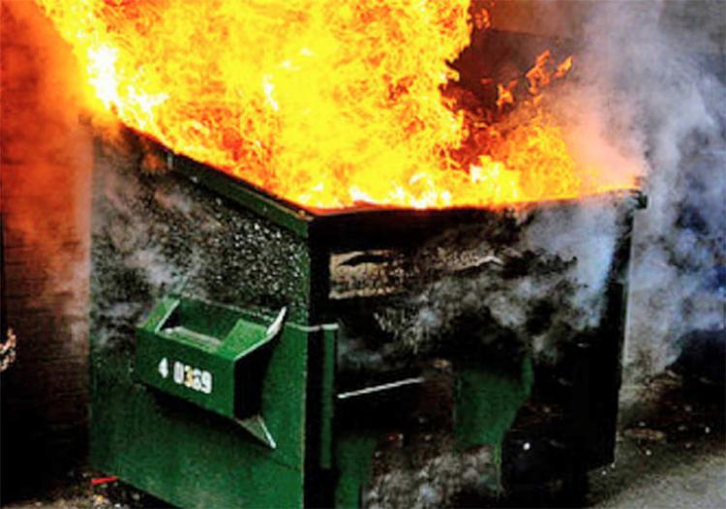
Backstory
Notes:
Got called onto to work on an app
That app was a mess
Fixed the mess with event driven architecture
Sometimes the common stuff doesn’t work

Slide 3
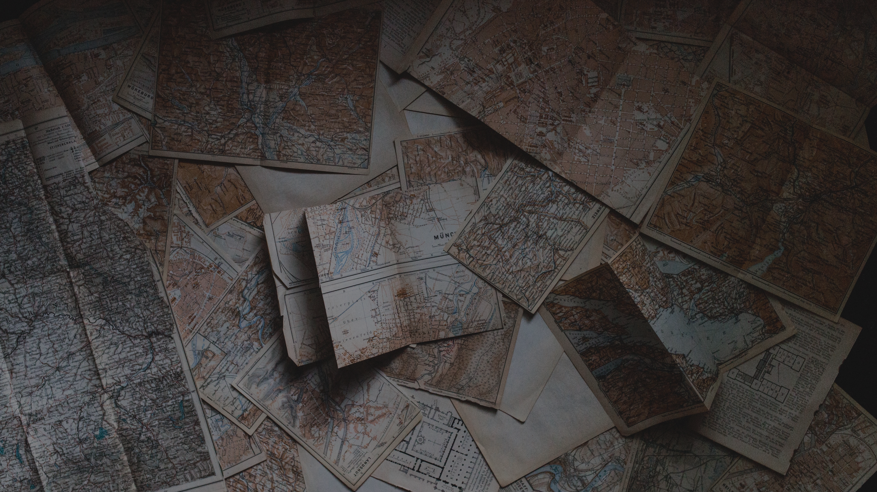
Roadmap
What
Why (and Why Not)
How
Demo
Notes:
Photo by Andrew Neel on Unsplash

Slide 4
What is Event Driven Architecture?
Notes:
I want to talk about a couple scenarios…
Using events to decouple microservices
Using events to monitor changes in state or streams of data

Slide 5
Monolith to Microservices
Notes:
Big giant app into smaller easier to manage apps
Scenario:
Customer Needs Their Order History
-------
Customer Service for customer data
Order Service for Order data
Product Service for Product data

Slide 6
Notes:
Multiple entanglements, so each area relies on someone else
Let’s a say we create a new customer

Slide 7
Long Running Processes
Payment Gateways
Binding Insurance Policies
Talking to Ancient Backend Systems
Reports
PDF/Video/Image Conversion
Batch Processes
Notes:
Things we would normally batch out

Slide 8
Data Flows
Sensor readings
Telemetry

Slide 9
What do these things have in common?
Notes:
Answer: Events
Event Driven Architecture is an architecture that deals with events

Slide 10
Components
Events
Producers
Message Brokers
Consumers

Slide 11
What is an event?
Notable thing that happens
Changes in state
New Customer
Temperature Reading
Shopping Cart Checkout
Lightweight
Easily Understood
Notes:
Ideally defined in business terms
Events should be understood by people

Slide 12
Consumer
Producer
Message Broker
Consumer
Consumer
Events

Slide 13
Event Patterns
Pub / Sub
Event Sourcing
Event Streaming

Slide 14
Pub/Sub
Subscriber
1
Queue
Queues
Topics
Subscriber
2
4
5
6
Subscriber
3
Subscriber
3
Topics
Subscriber
3
4
5
6
Subscriber
3
Notes:
Pub/Sub
Queues – process once
Useful for load leveling
Topics – multiple subscriptions
Useful for decoupling systems

Slide 15
Event Sourcing
Append only
Replay events for state
Materialized Views
Easy to track history
Deposit $100.00
Withdraw $10.00
Withdraw $20.00
Account Balance $70.00
Notes:
https://docs.microsoft.com/en-us/azure/architecture/patterns/event-sourcing Event Sourcing
– events are kept and can be replayed for state (think accounting)
Good for data that needs history and auditing
Good for data that has lots of people adding to it, like inventories

Slide 16
Event Streaming
Common in IOT
Notes:
Event Streaming – streams of information, often used in IOT

Slide 17
Why Event Driven Architecture?

Slide 18
Decoupling Apps
Promote loosely coupled architecture
Easy to add consumers later
Subscriber
Customer Service
Customer Update Topic
Subscriber
Subscriber
Notes:
Without the topic, the Customer Service needs to keep track of all the calling services it needs to call to update them on the customer.
With the topic, the Customer Service just needs to do one thing

Slide 19
Scaling
Load Leveling
Alter processors to control flow rate
Large Data Streams
Processor
1
Queue
Processor
Add or subtract
processors as needed
2
4
5
6
Processor
3
Notes:
Kubernetes – can auto scale
Or you can have queue-based scaling mechanisms
Or you can use queuing on prem to not destroy your on prem infrastructure

Slide 20
Pitfalls
Consistency Problems
Event Delivery Failures
Multiple processing of events
Notes:
Consistency Problems – Eventual consistency | you can’t post and then retrieve
Event Delivery Failures – Sometimes events don’t get where they need to go
Multiple processing of events – Sometimes you get more than one event, make your services Idempotent

Slide 21
More Pitfalls
Thundering Herd Problem
Complexity
Notes:
Thundering Herd – one service update triggers a bunch of callbacks to the OG service
Complexity

Slide 22
How do I do Event Driven Architecture?
In Azure

Slide 23
Cheap Ways
Storage Queues
Database
Notes:
Storage Queues – a cheap type of storage account. Usable, but not terribly reliable
Database – just make a table, works with batch processes and other obvious queuing solutions

Slide 24
Azure Services
Event Grid
Event Hub
Service Bus
Notes:
Event Grid – Azure/Infra Events
Event Hub – IOT type events
Service Bus – Business Events
https://docs.microsoft.com/en-us/azure/event-grid/compare-messaging-services

Slide 25
Event Grid
Orchestrate Azure Events
Pub/Sub

Slide 26
Event Hub
Event Streaming
Telemetry
IOT

Slide 27
Service Bus
Business Events
Topics
Queues

Slide 28
Service Bus APIs
Azure.Messaging.ServiceBus (New)
Microsoft.Azure.ServiceBus
WindowsAzure.ServiceBus (Old)
Notes:
You’re going to find links to each of these in the docs. It’s kind of annoying…
https://github.com/Azure/azure-sdk-for-net/blob/Azure.Messaging.ServiceBus_7.0.0/sdk/servicebus/Azure.Messaging.ServiceBus/README.md

Slide 29
Demo – Payment API
Service Bus Queue
Main Game App
(ASP.NET App)
Payment Process (Function App)
Service Bus Topic
Notes:
Felt this would be less boring than fixing a batch app
This pattern applies to any long running process that needs to be async-ed

Slide 30
Building Event-Driven Applications Using Azure
Dustin Ewers
Centare
www.dustinewers.com
https://www.linkedin.com/in/dustinewers/
https://github.com/DustinEwers/event-driven-arch-azure

